Slide 1
Being a Bearcat

Slide 2
The Bearcat Bond
"As a member of the University of Cincinnati, I will uphold the principles for a Just Community and the values of respect, responsibility, and inclusiveness. I will promote the highest levels of personal and academic honesty and aspire continuously to better myself, the Bearcat community, and the world.”

Slide 3
Student Code of Conduct

Slide 4
Purposes
To inform students of their rights and responsibilities as Bearcats and representatives of our university
To identify ways to address student behavior that conflicts with university values and policies
To recommend interventions and measures designed to educate the Bearcat community

Slide 5
Your Responsibilities
Knowing and honoring the Student Code of Conduct
Maintaining the established standards of “Scholarship” and “Conduct” that are essential to the educational mission and community life of the university

Slide 6
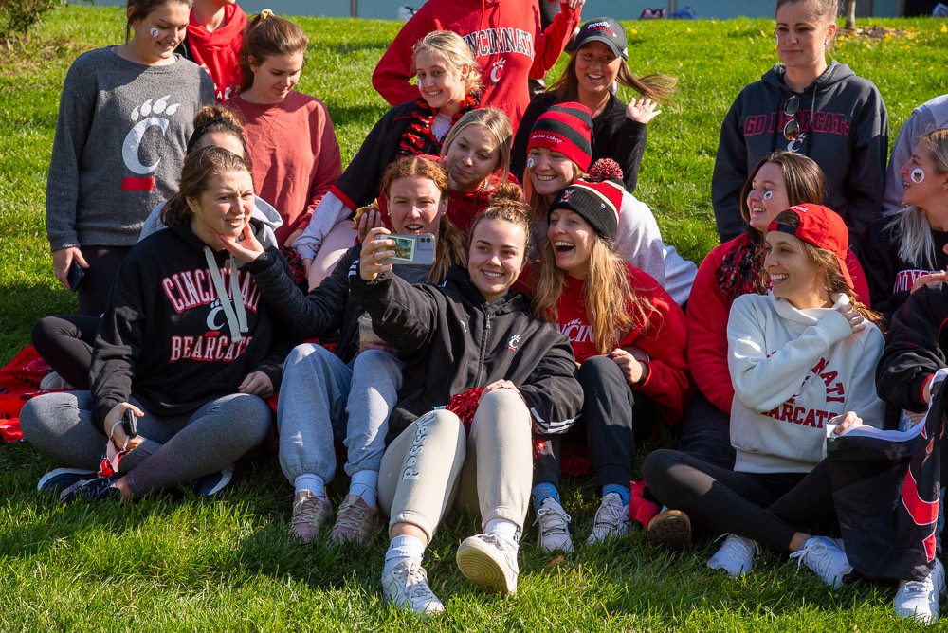
On-Campus Behavior
Applies to student conduct that occurs on any university campus or on university-owned leased/controlled premises.
Applies to conduct that occurs during remote or online learning or other University related events/activities.

Slide 7
Off-Campus Behavior
Applies to off-campus conduct when the behavior/the presence of a student (or student organization) impairs, obstructs, or interferes with the mission, process, or functions of the university.

Slide 8
Amnesty Policy, pt 1
The university’s primary concern is the health, safety, and welfare of its members.
To maintain a safe and scholarly community, the university encourages students to report code of conduct violations and crimes involving a victim, including sexual misconduct.

Slide 9
Amnesty Policy, pt 2
To encourage reporting, the University of Cincinnati has the discretion not to pursue certain non-violent code violations such as use of alcoholic beverages or drugs related to the incident.
May be applied to parties, bystanders, witnesses, students, or student organizations who participate in the conduct process.

Slide 10
Amnesty Policy, pt 3
May also be applied to students who seek assistance for themselves or others experiencing an alcohol and/or other drug-related emergency.
Will be determined on a case-by-case basis.
Students receiving amnesty may be required to participate in an educational conference.

Slide 11
Student Resources

Slide 12
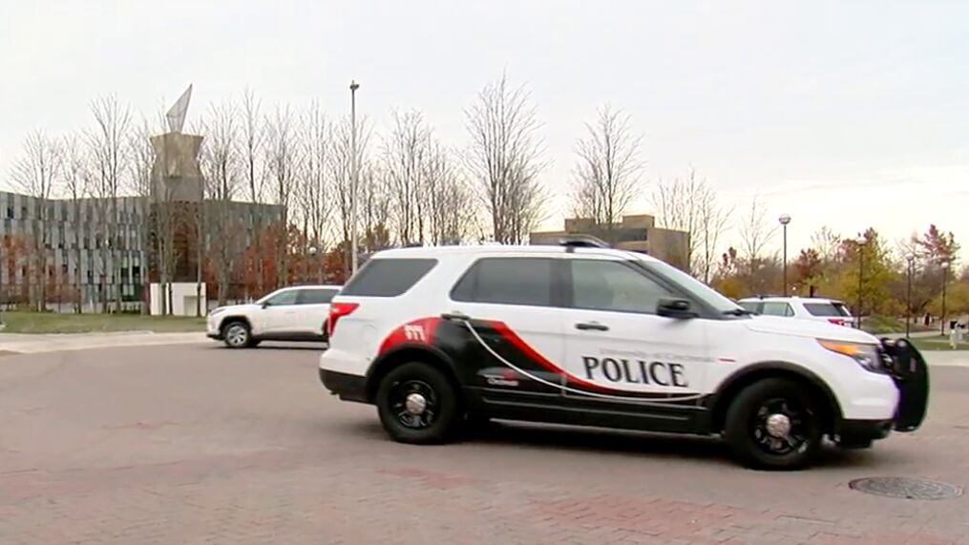
Student Safety on Campus
Resources/Services
Bearcat Guardian
Blue Light Phone Poles
UC Alert (text, email)
Fire Safety Inspections
Patrol
Crime prevention education
Event security
Door unlocks
...and MORE!
UC Public Safety is committed to providing a safe campus environment for students, faculty, staff and visitors.
Psst, Look at the back of your Bearcat Card for some helpful phone-numbers!

Slide 13
Title IX
This is a Confidential Resource except:
To conduct an appropriate investigation
To provide assistance and resources to University community members
To perform other appropriate University functions
When it is necessary to produce information in accordance with applicable law and/or other controlling authority
Information goes up, but never out.
…is a Federal law that prohibits discrimination on the basis of sex in a university’s programs or activities.
Including but not limited to:
Sexual harassment
Sexual violence
Threats
Retaliation
Making a Report:
Via phone, email, walk-in, online, or representative visit

Slide 14
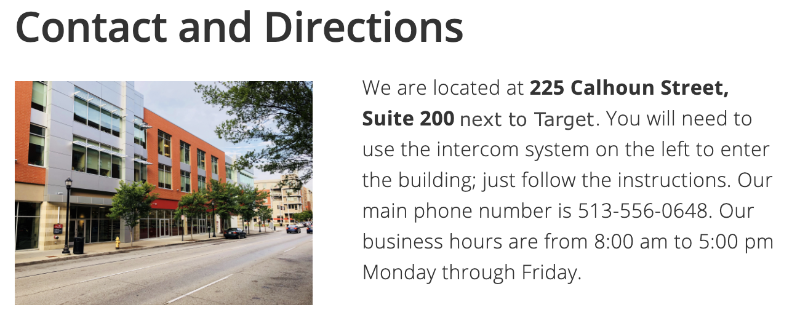
Counseling and Psychological Services (CAPS)
“UC CAPS achieves excellence through community-based integrated care approach. Creates an optimal and healthy environment for students to grow.”
Initial consultation and first three visits are of no cost to students.
24-Hour Crisis Line
(513) 556-0648
Free online mental wellness resources:
Racial Trauma
“Let’s Talk”
Wellness Workshops
Therapy Assistance Online

Slide 15
Accessibility Resources
We are committed to providing full and equal access to students, employees, and visitors with disabilities. UC is actively engaged in improving accessibility both in the community and in the classroom.
Office Location: Commons Edge Pavilion North
Phone: (513) - 556 - 6823
Fax: (513) - 556 - 1383
Hours: Monday-Friday, 8am - 5pm
E-Mail: accessresources@uc.edu
Available Services
CART Writing
Accessible Tech.
Service Animals
Housing Accommodation
Many, many more!
*Students must fill out an accommodation form for most requests.

