Slide 1
College of Cooperative Education and Professional Studies

Slide 2
WHAT CAN THE BEARCAT PROMISE CAREER STUDIO DO FOR ME?
Notes:
This presentation is designed to last 20-30 minutes.

Slide 3
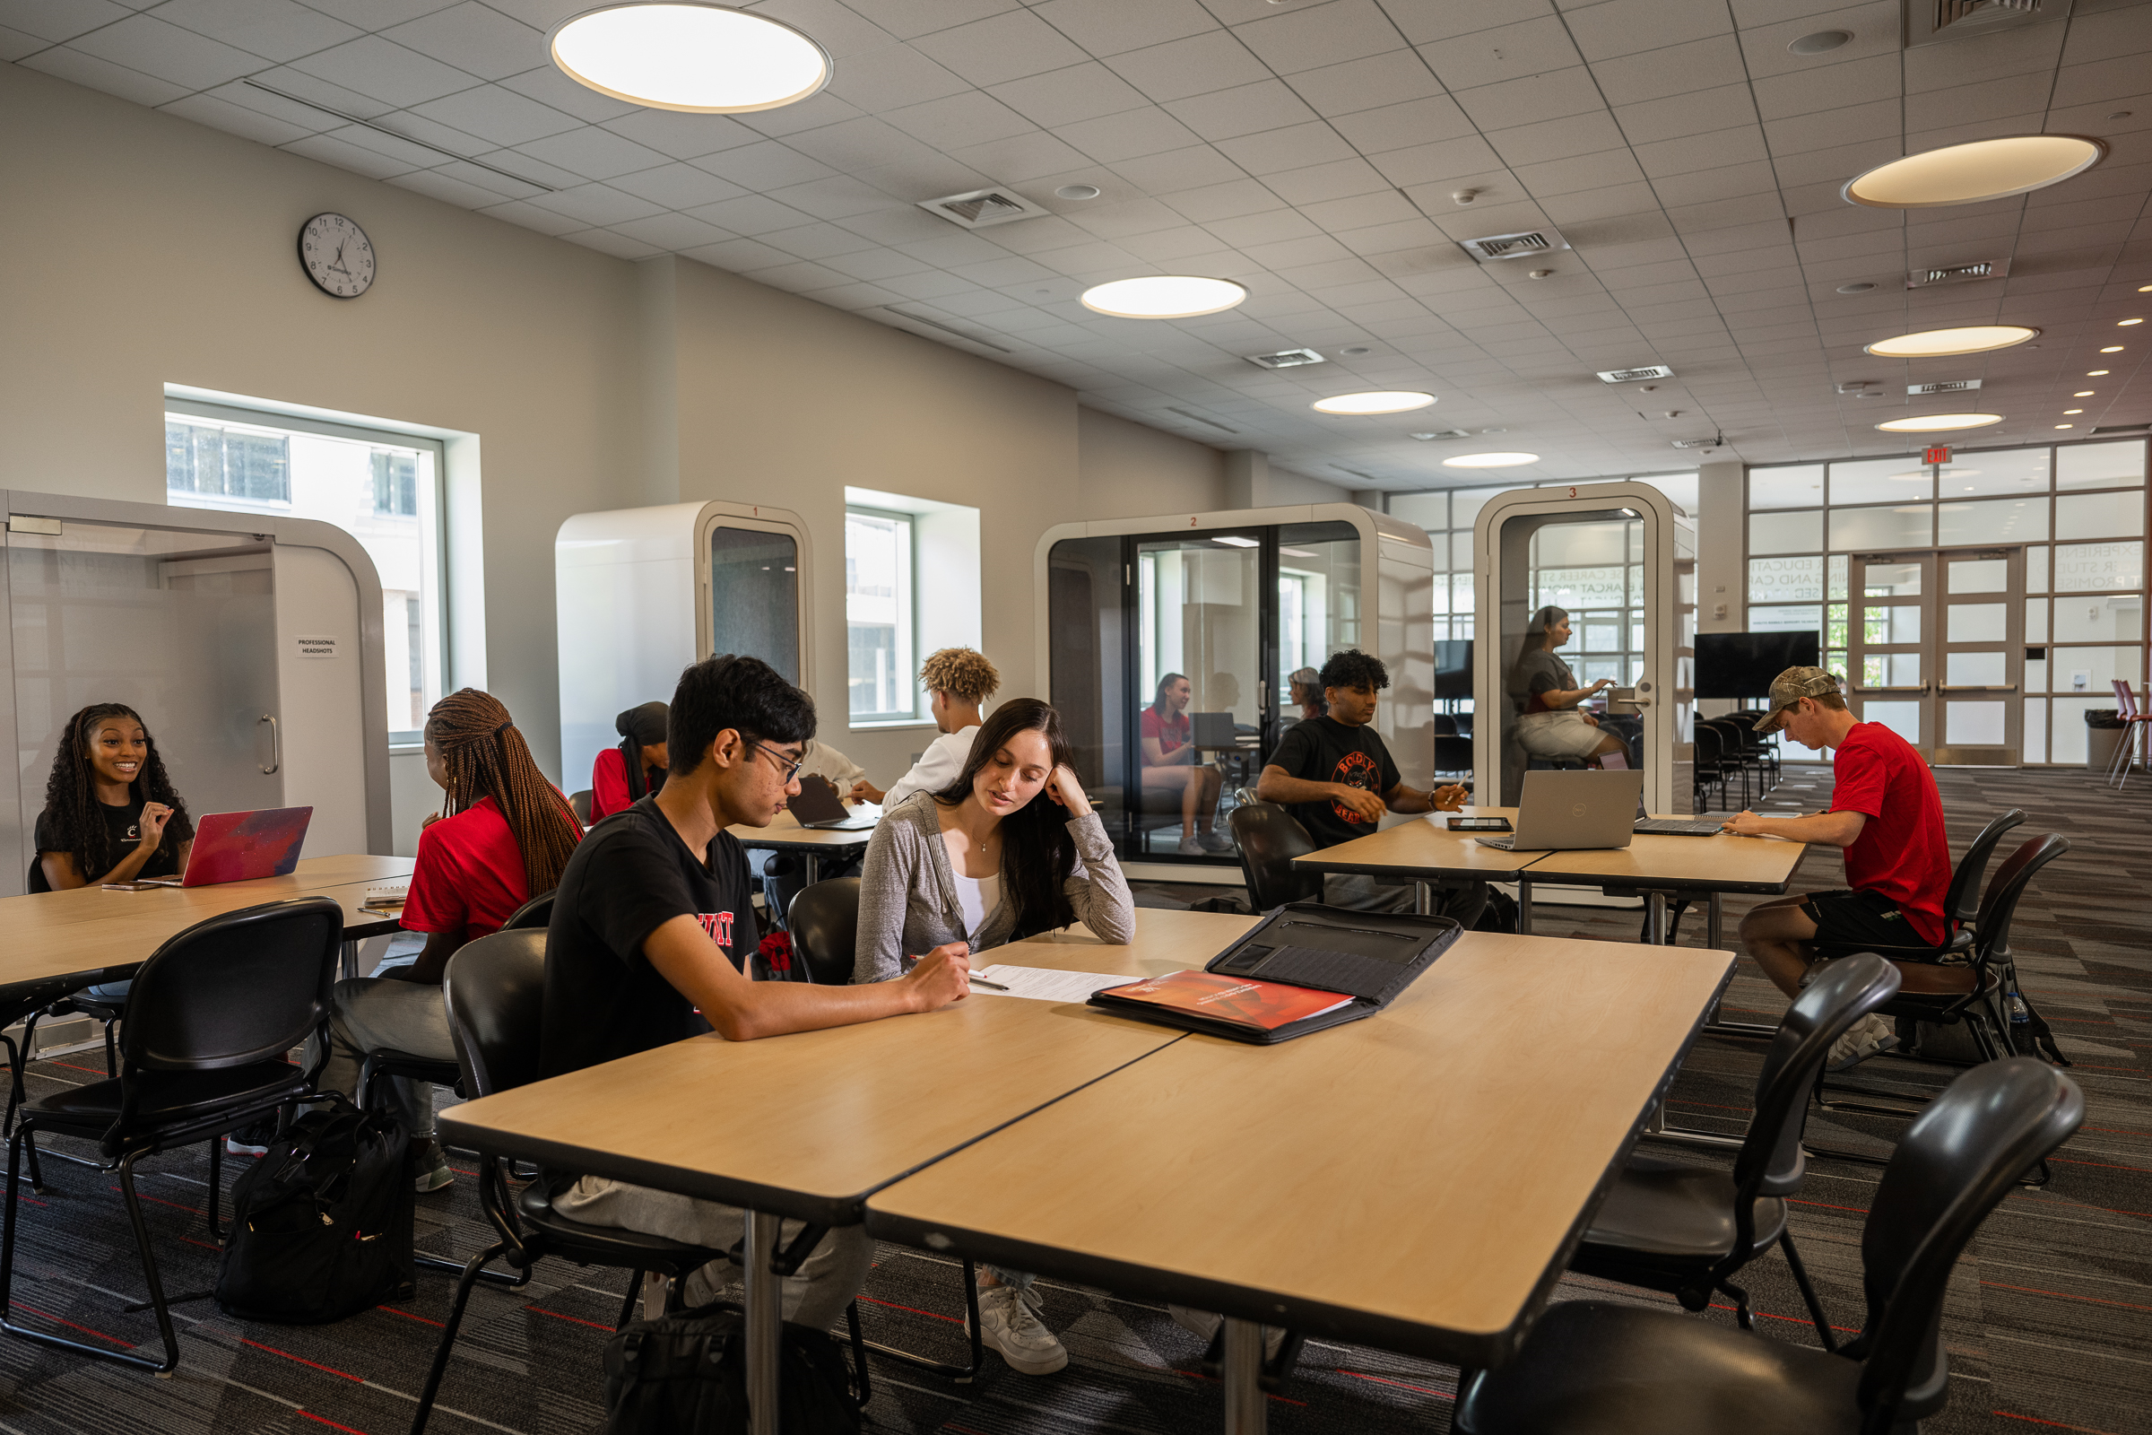
CAREER STUDIO
What is a Career Studio?
A place where you can meet with a trained team of career professionals to discuss and design your future.
Who We Serve
Undergraduate and graduate students
Recent alumni
Lindner and Law have centers
Location
Tangeman University Center (TUC) 310
By the PNC Bank

Slide 4
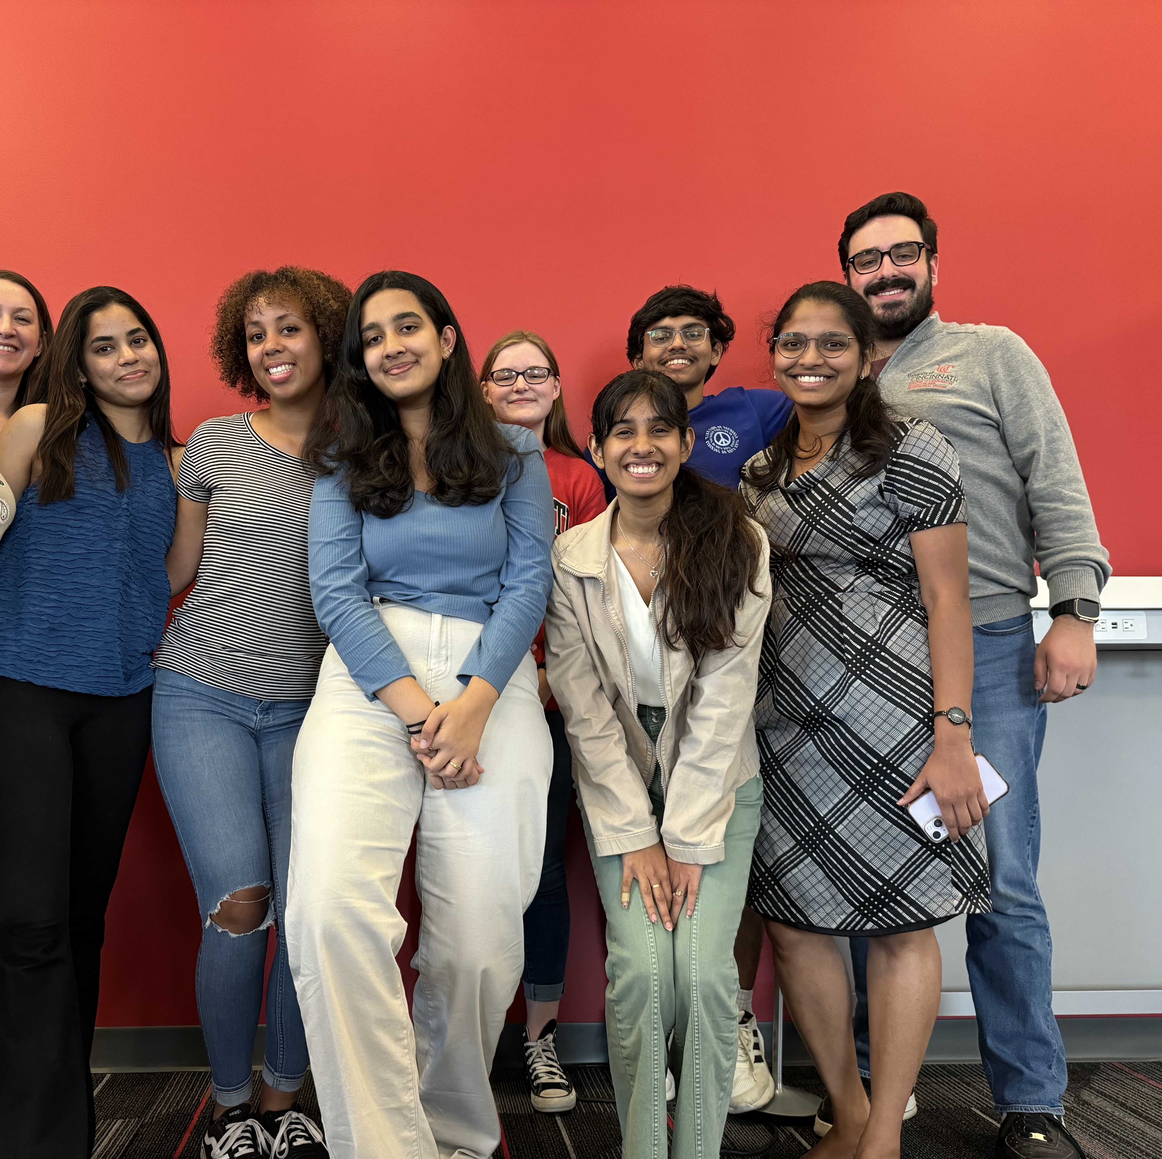
OUR CAREER STAFF
Our team looks forward to supporting you in your career journey!
Peer Career Coaches (10 students)
Graduate Assistants (1 graduate)
Professional Staff (2 Professionals)

Slide 5
REQUESTING CLASSROOM PRESENTATIONS
Option 1: Surface level presentations
Peer Career Coaches present
Option 2: In-depth level presentations
Professional staff present
*Email The Career Studio: careerstudio@ucmail.uc.edu

Slide 6
WALK-IN HOURS
Peer Career Coaches
Undergraduate and graduate students with specialized training in career topics
Walk-In Services
No appointment needed (10am – 4pm)
Receive advice on resumes, CVs, cover letters and other professional documents
Learn how to use Handshake, LinkedIn, Bearcats Connect, etc. to find co-ops, internships, and jobs
Learn best practices on attending a career fair
Practice for an upcoming interview and receive feedback

Slide 7
CAREER COACHING
What is Career Coaching?
Professional Staff and Graduate Assistants
We provide information and guidance on career topics that you are interested in exploring.
Topics
The following slides include topics that students regularly schedule a Career Coaching appointment to discuss.

Slide 8
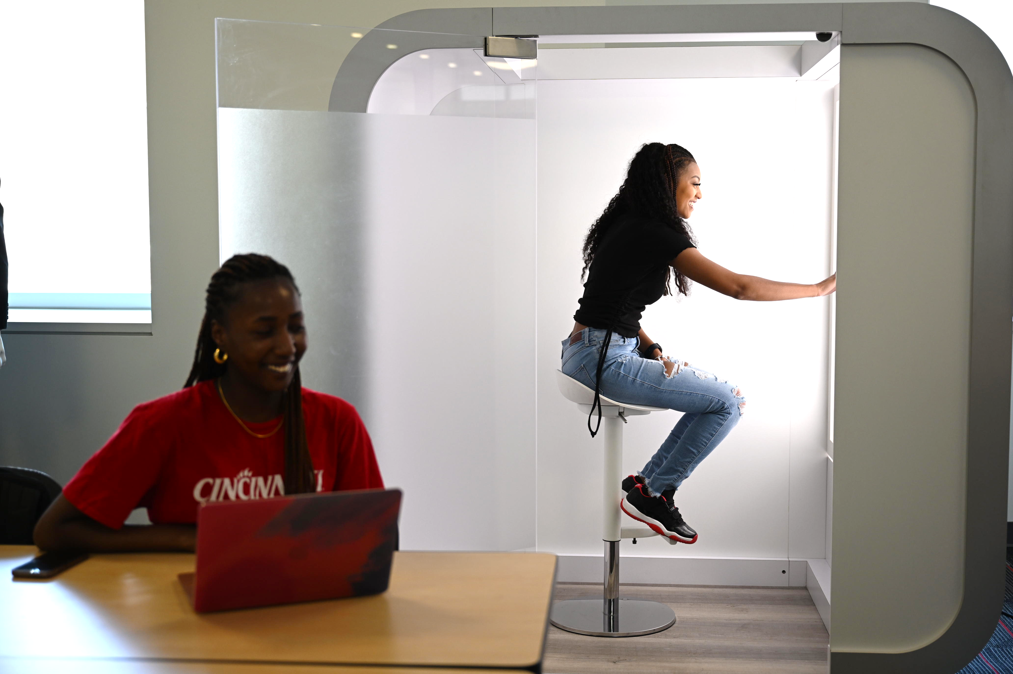
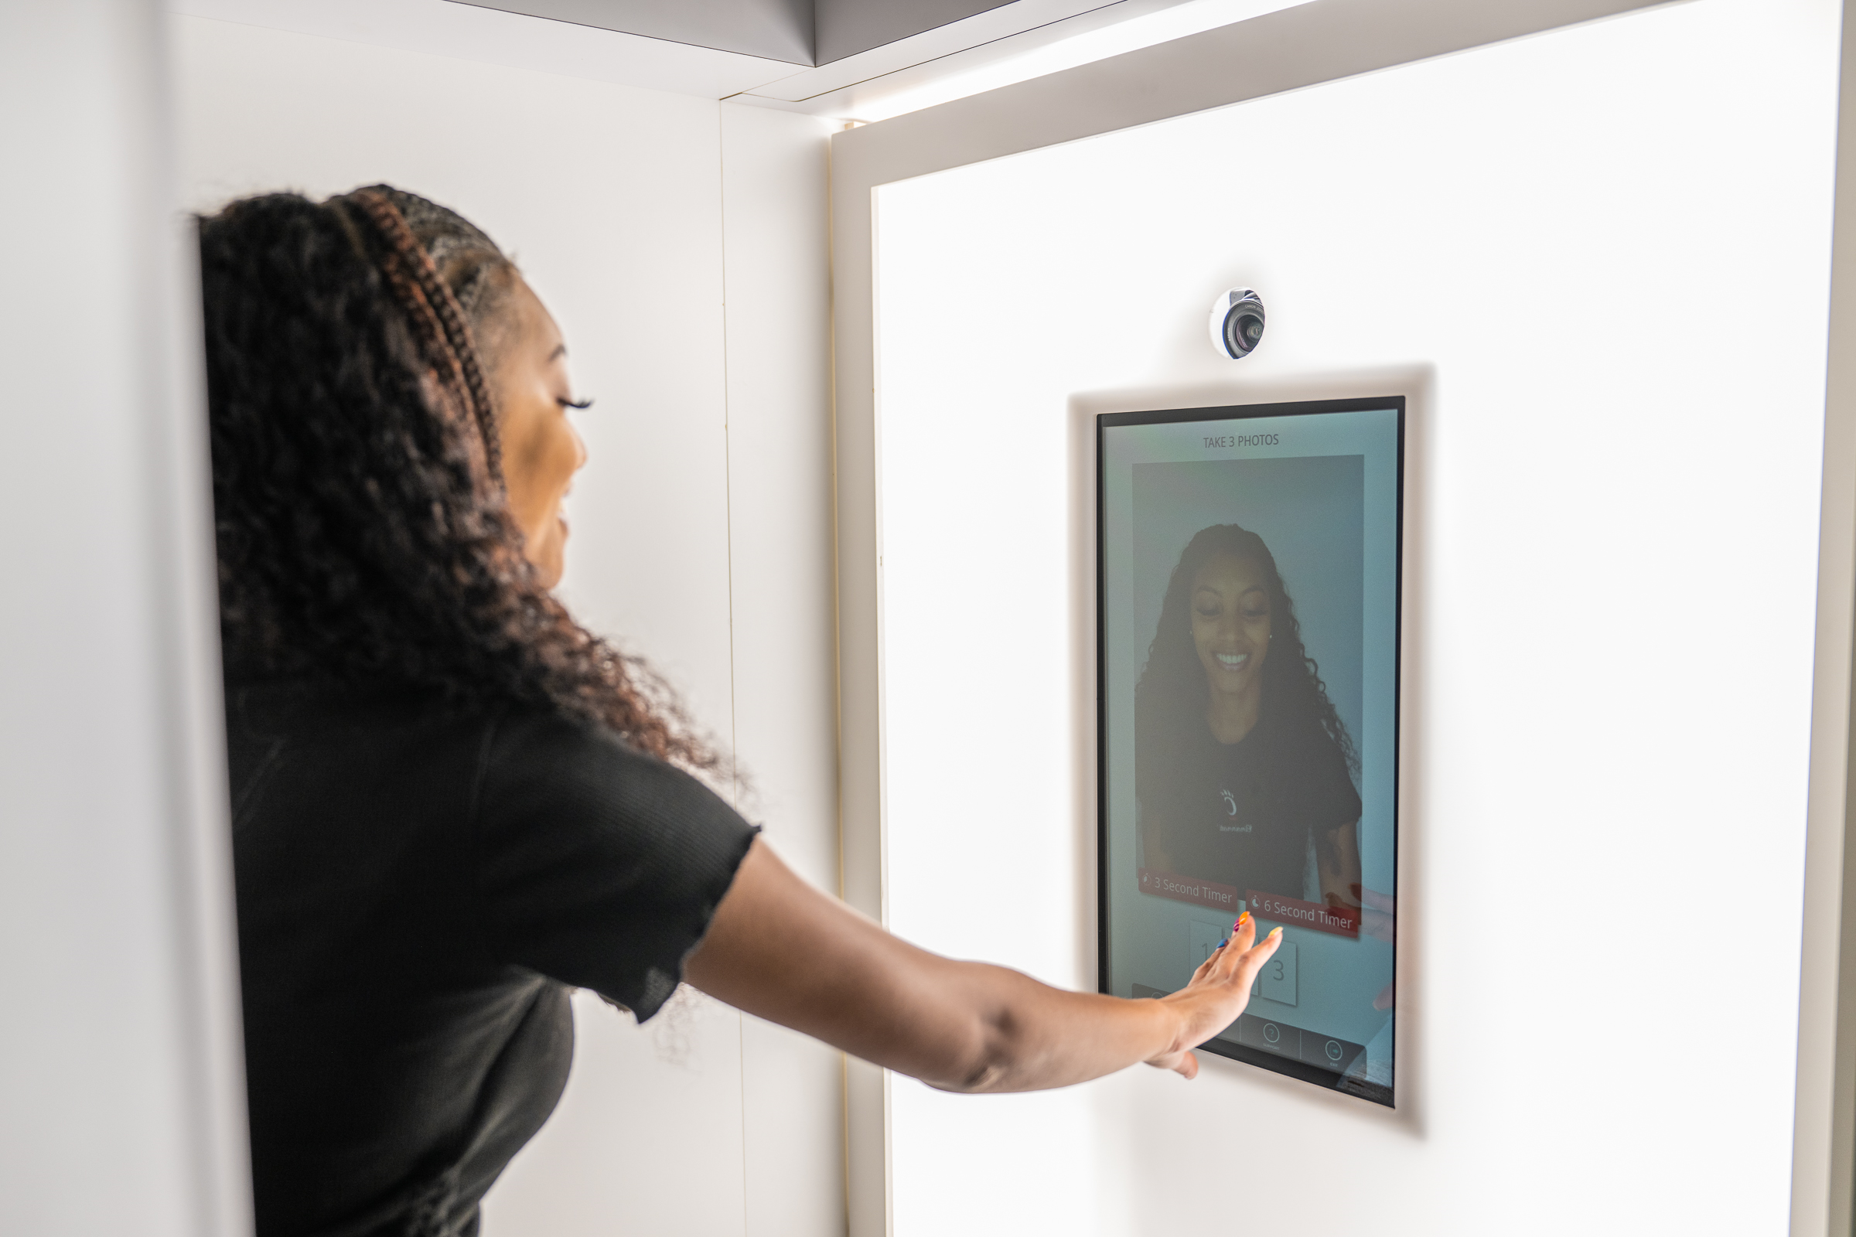
FREE HEADSHOTS
Add a headshot to your Handshake and LinkedIn profiles!
Capture 3 free headshots per session
It’s self-service, takes about 5 minutes, and will provide you with posing tips and advice.
Digital images are in your email within 10 minutes
Come back as many times during walk-in hours as you would like – seriously!

Slide 9
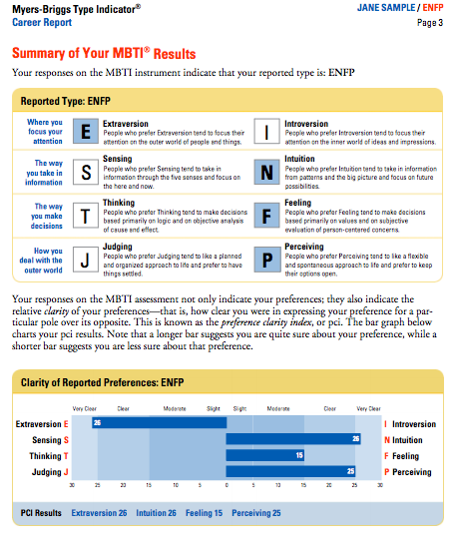
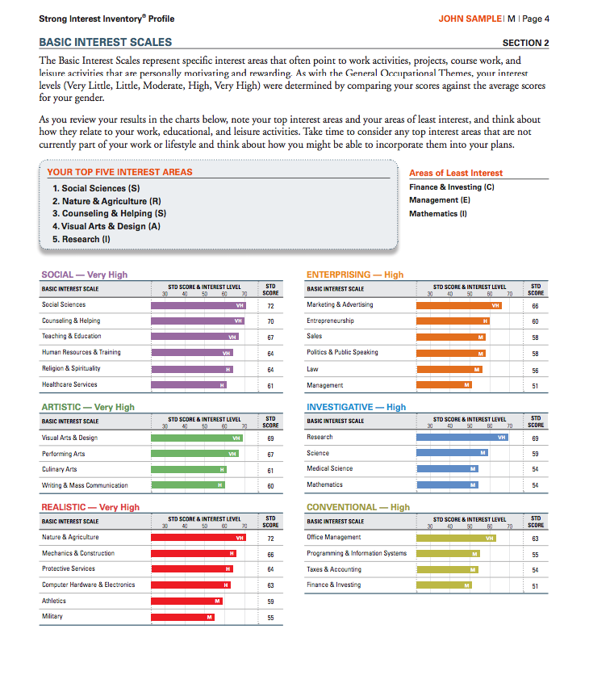
WHAT CAREERS COULD BE A MATCH FOR ME?
Listen to what options you are considering and help you determine which could be the best match for you.
Help you understand what careers could be a match for you using personality and career assessments.
Notes:
Personality tests include: Myers-Briggs, Strong Interest Inventory,

Slide 10
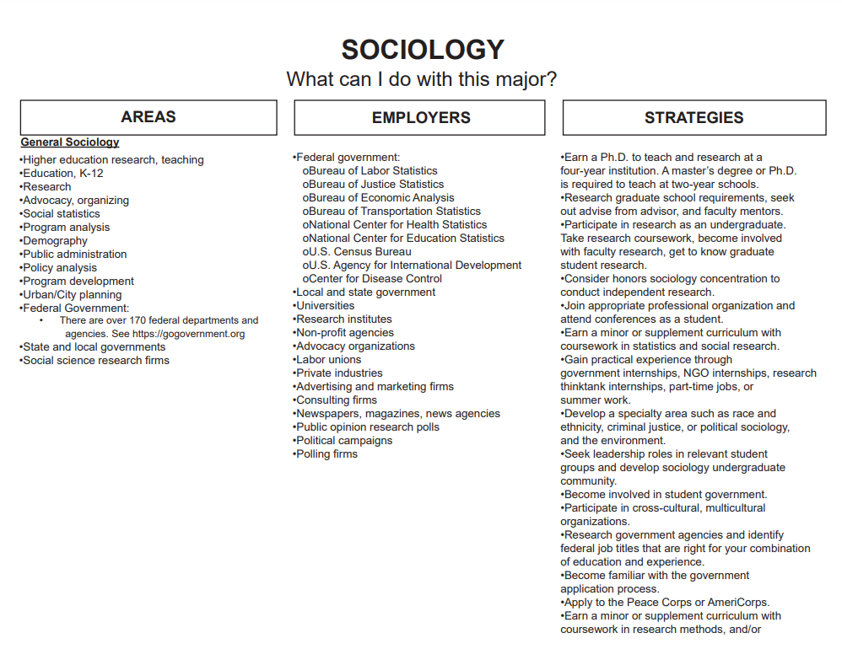
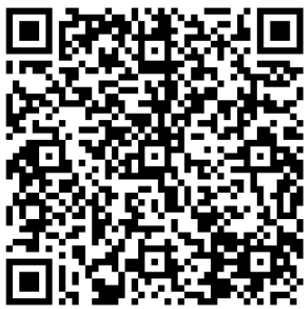
WHAT CAN I DO WITH MY MAJOR?
Still deciding on a major or curious about typical careers people pursue with your major?
Check out the What Can I Do With My Major? tool.
Notes:
Resource Link: https://www.uc.edu/campus-life/careereducation/career-studio/choose/explore/what-can-I-do-with-this-major.html

Slide 11
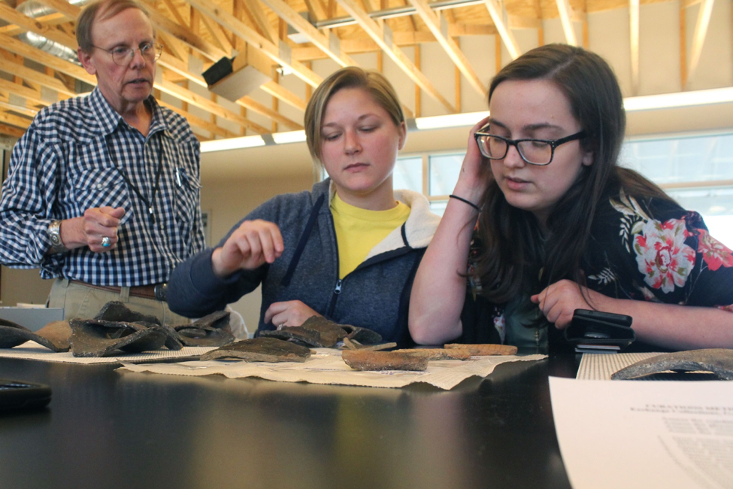
HOW CAN I GET EXPERIENCE IN THE FIELD?
Connect you with UC’s experiential learning programs, including:
co-op (full-time, part-time, service learning, on-campus)
Service Learning
UC Forward
Undergraduate Research
International Experiential Learning
Co-explore student clubs and organizations
Discuss part-time jobs to gain relevant skills

Slide 12
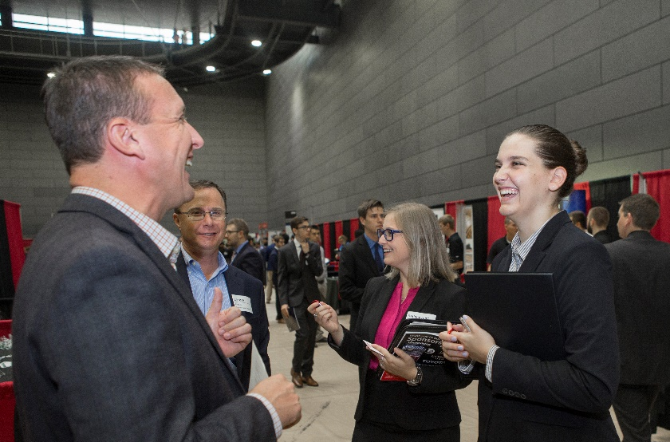
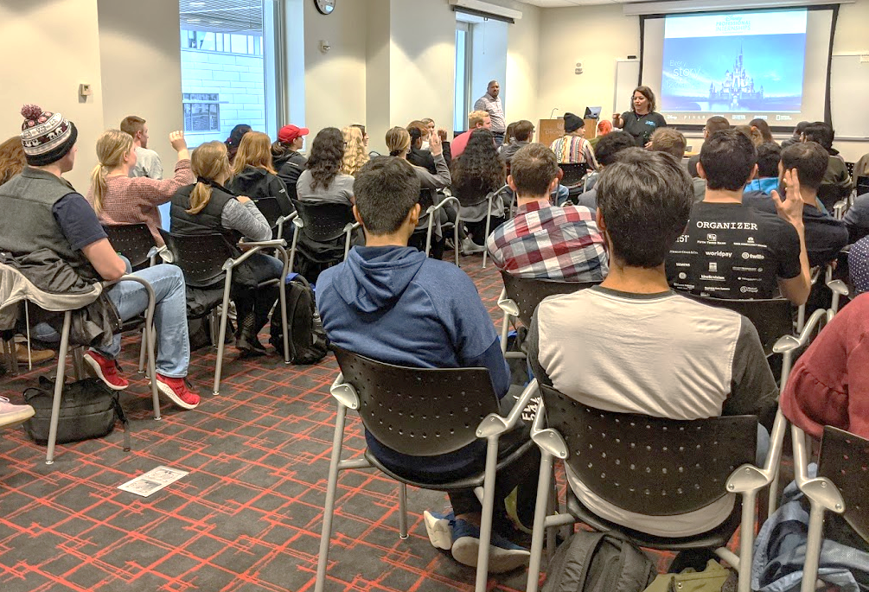
HOW DO I FIND A FULL-TIME JOB?
Chat about the type of roles you are interested in.
Help you set up your job search filters in Handshake and LinkedIn so you see opportunities that fit your interests.
Discuss upcoming career fairs and employer information sessions.
Review your professional documents and profiles
Conduct mock interviews

Slide 13
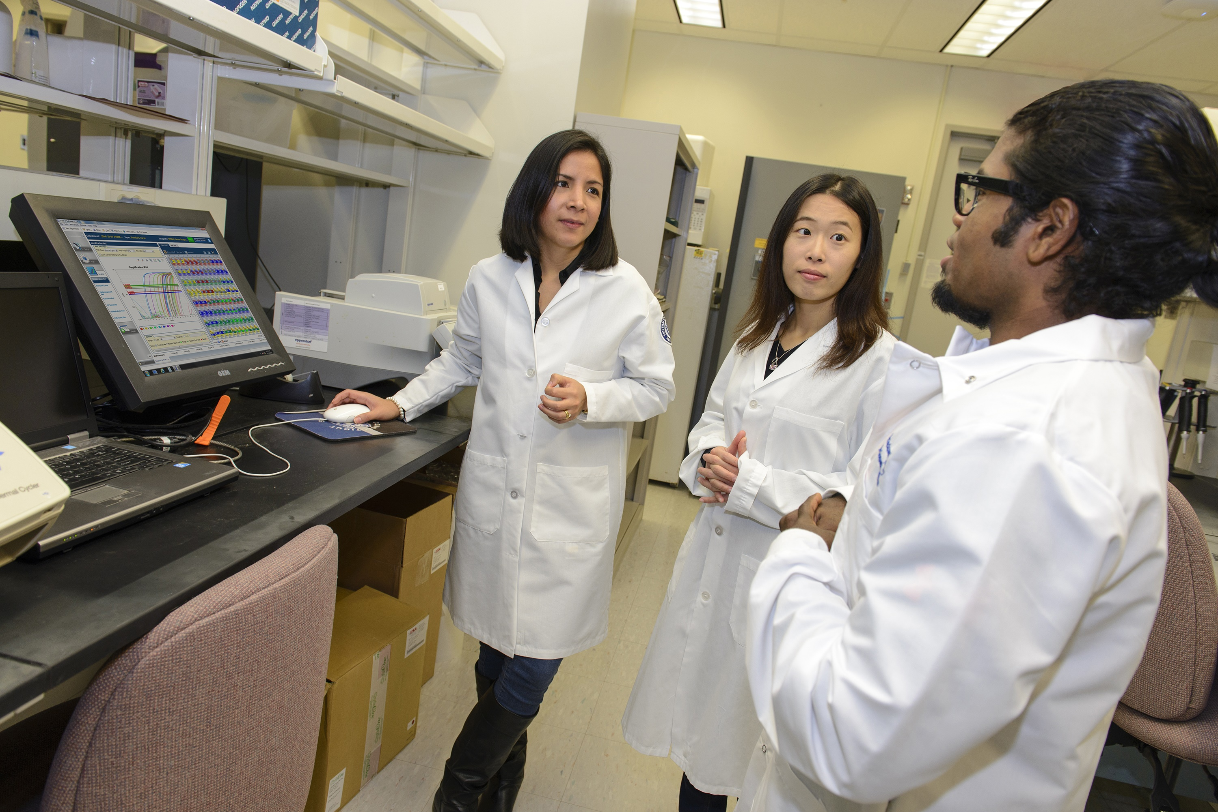
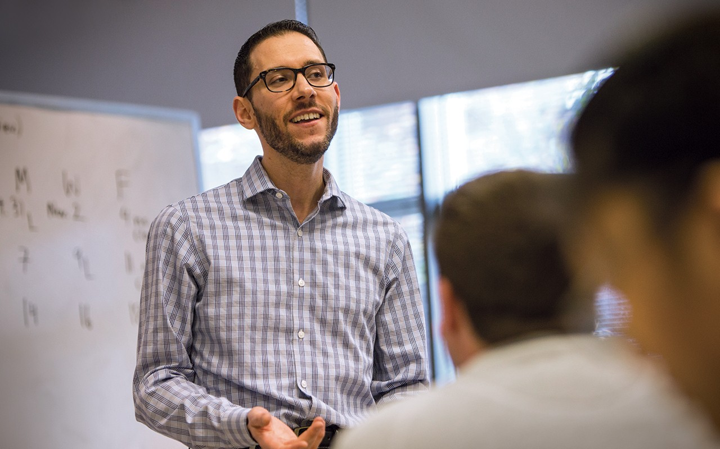
HOW DO I GO TO GRADUATE SCHOOL?
Chat about the type of programs you are considering.
Discuss the differences between Master’s and PhD level programs
Help you understand the application timeline, what application materials are required, and ways to finance your education
Review your professional documents, including resume, CV, and/or personal statement
Conduct mock interviews and provide feedback

Slide 14
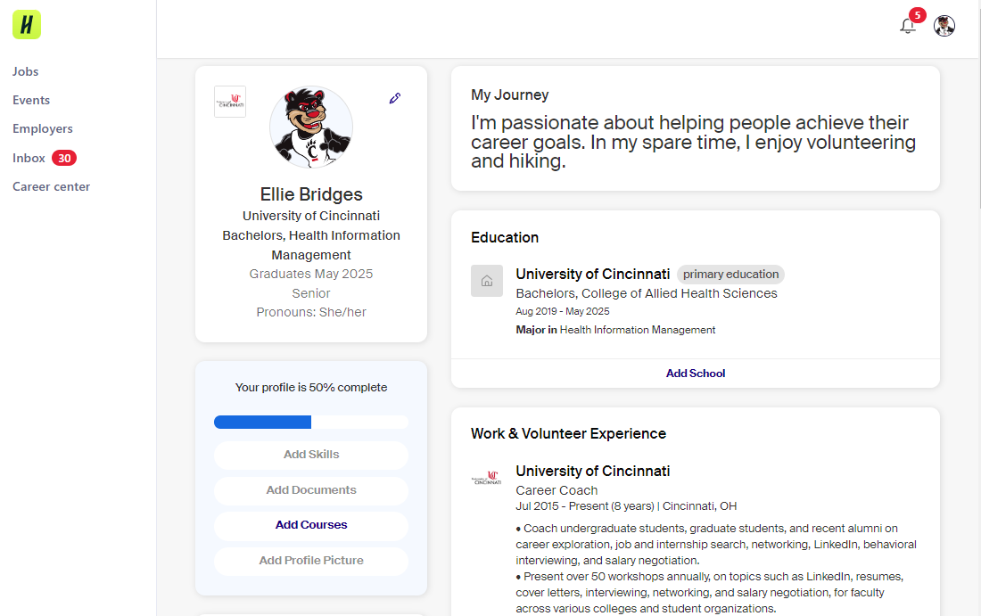
HANDSHAKE
UC’s career platform
Find co-ops, internships, and full-time jobs as well as on-campus and local part-time job opportunities
View upcoming career fairs
Schedule appointments with the Career Studio
Activate your account at uc.joinhandshake.com using your 6+2 and UC password.

Slide 15
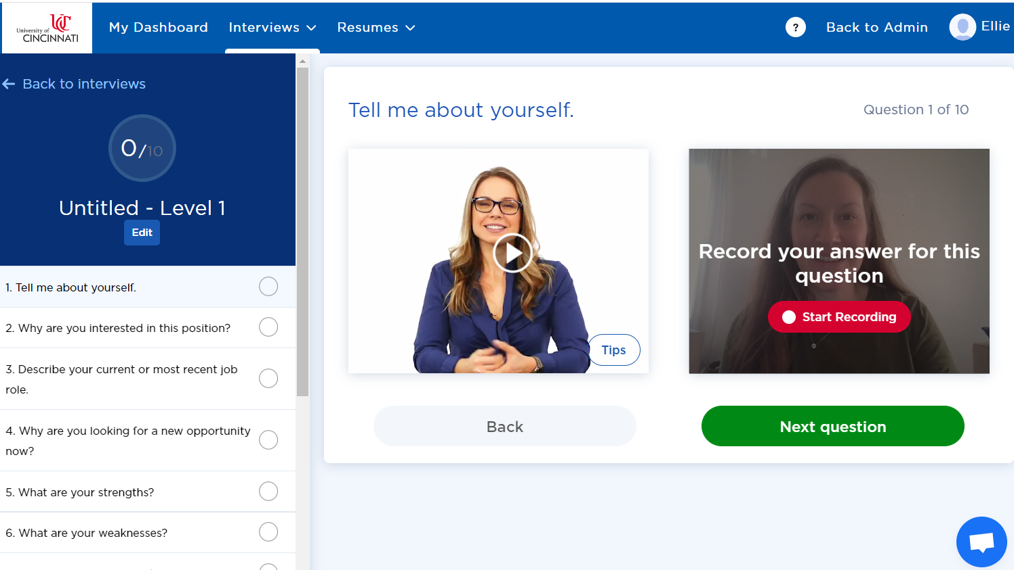
BIG INTERVIEW
Big Interview is an AI job training site
To improve your answer responses, you can use the STAR tool to build your answers
Activate your account at uc.biginterview.com using your 6+2 and UC password
Notes:
Practice your responses to common interview questions, do interview roulette, or you can review your previous videos and receive feedback

Slide 16
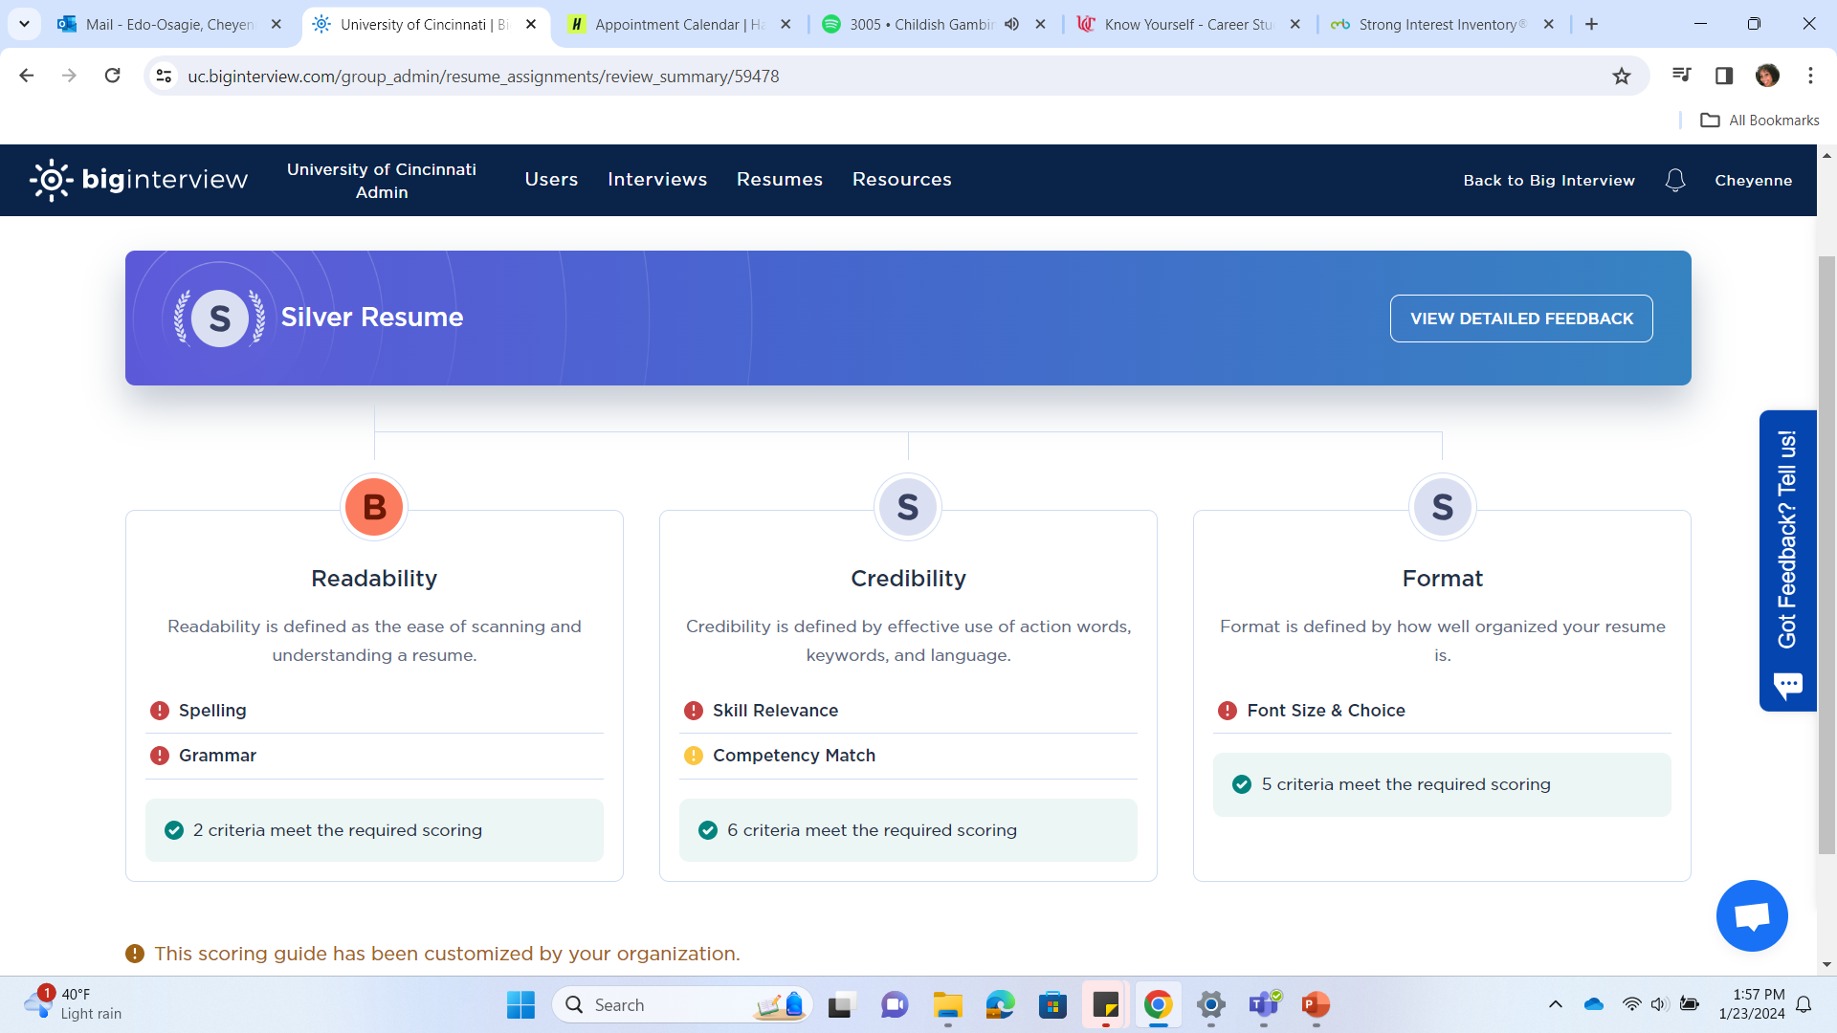
BIG INTERVIEW
Not only can you use BigInterview to do interview practice, but now we utilize the resume AI feature!
Receive AI feedback on your resume submissions with rankings of Bronze, Silver, and Gold
You can submit five resume submissions at one time
Notes:
- Resume submissions can be reset if necessary. Let students know they can contact us (BPCS) to get the daily limit reset

Slide 17
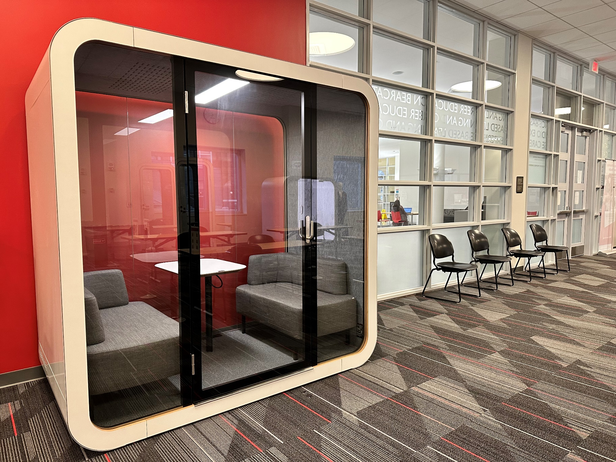
INTERVIEW PREP
Need a quiet, reservable place for an interview?
Sound dampening booths
2 booths for a single person
2 booths for up to 2 people
Call the Career Studio at 513-556-0381 or email careerstudio@uc.edu to request a reservation.

Slide 18
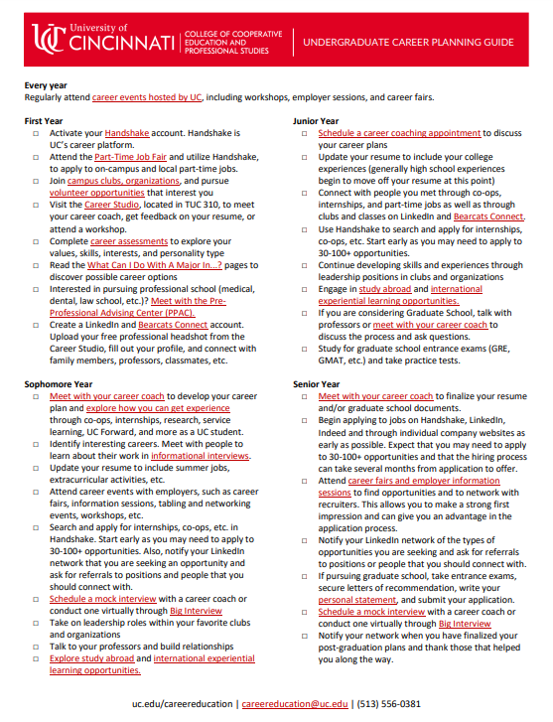
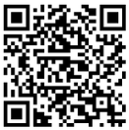
FOUR-YEAR CAREER GUIDE
Want a guide to ensure you are ready for life beyond UC?
Download a copy of our Undergraduate Career Planning Guide to track your progress.
Notes:
We’re here to support you but we also want you to know how to proactively get involved in setting yourself up for career success and when to get started.

Slide 19
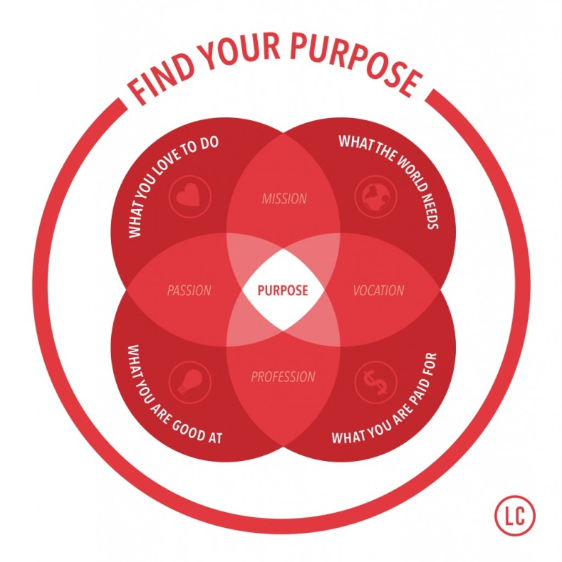
QUESTIONS?
Bearcat Promise Career Studio
College of Cooperative Education & Professional Studies
Website: uc.edu/careereducation
Email: careerstudio@uc.edu

